Slide 1


Measuring and Improving Performance
Carmen Garro
Luke Smith

Slide 2


What is performance?
How quickly can the computer undertake a particular task given a code
*Balance between code efficiency and programmer productivity

Slide 3


Is R an efficient coding language?
Language designed to make data analysis and statistics easier for people.
It is not a language designed with an efficient performance in mind.
Source: Programming Languages Benchmark (2011) Available at: https://attractivechaos.github.io/plb/

Slide 4




Why is improving performance important?
The less efficient the code, the more time it takes processing data
i.e., reduce bottlenecks in your code
Less memory usage
CO2 emissions from energy usage with high intensity computing

Slide 5
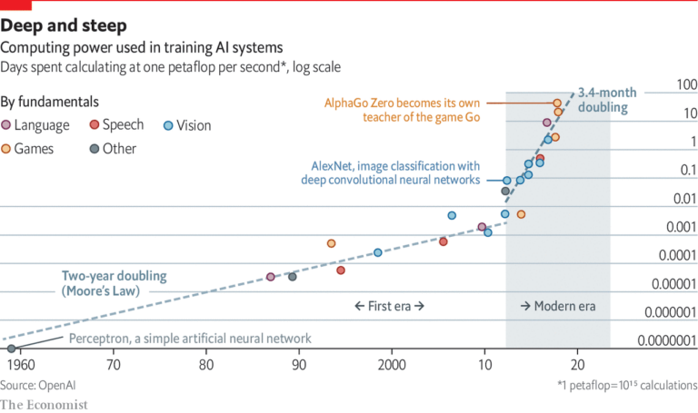
Environmental Considerations

Slide 6





Environmental Considerations
Training models is much more energy intensive than using them
“Aligning artificial intelligence with climate change mitigation” from Professor Lynn Kaack
Relevant at intense levels of computing, think Facebook and Google
Unlikely to affect your locally produced code for class
Increasingly important as AI and machine learning continue to increase in prevalence and usage
Google’s machine translation system may process more than 100 billion words per day
Facebook’s datacenters are re-trained anywhere from hourly to multi-monthly
Important to keep in mind for your future career

Slide 7




How to make your code more efficient?
Start by identifying “bottle necks”
Experiment with alternatives to find faster code
Profiling
Benchmark

Slide 8
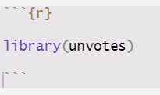
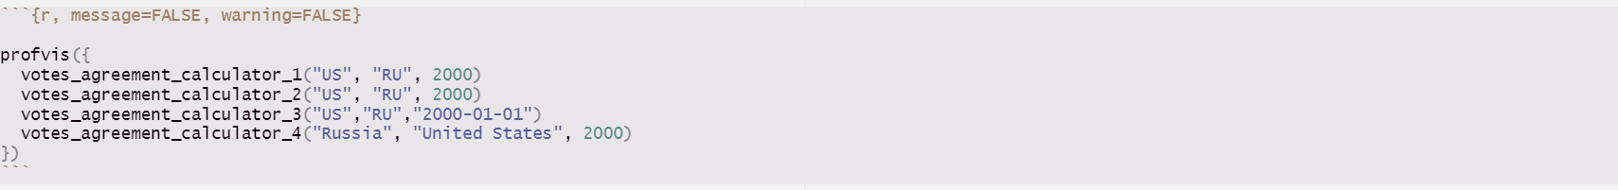
Profiles
Your code profile will measure key factors in each line of code
Run-time
Memory
Garbage collector
Function 1
Function 2
Function 3
Function 4
Percentage rate of equal votes of two countries starting a specific year
%

Slide 9
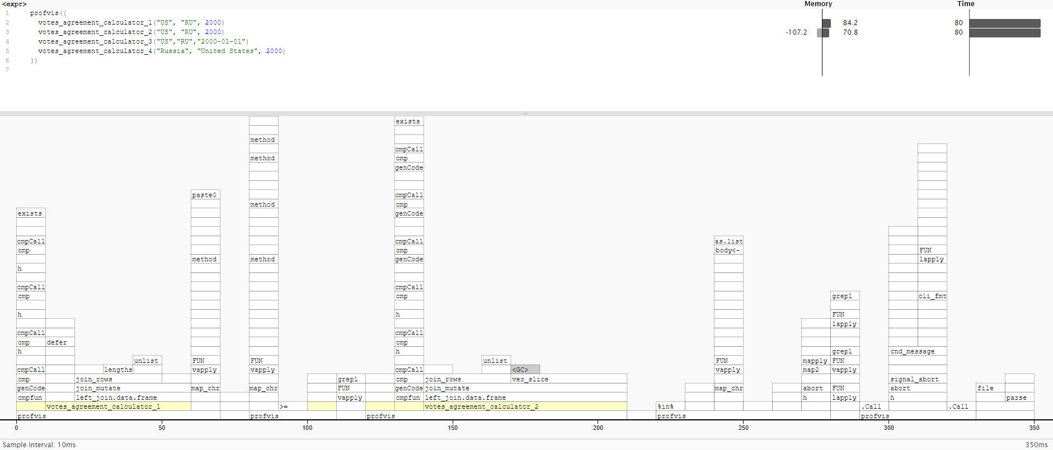
Visualizing Profiles
Vis output shows the source code, overlaid with bar graphs for memory and execution time for each line of code.
The bottom pane displays a flame graph showing the full call stack. It allows to see when objects are called more than one time. This is also displayed in the data tab, which let's you zoom interactively.

Slide 10
Benchmark
Always uses the highest precision APIs available for each operating systems (often nanoseconds)
Tracks memory allocations for each expression
Tracks the number and type of R garbage collections per expression iteration
Verifies equality of expression results by default, to avoid accidentally benchmarking inequivalent code
Uses adaptive stopping by default, running each expression for a set amount of time rather than for a specific number of iterations
Expressions are run in batches and summary statistics are calculated after filtering out iterations with garbage collections, to isolate the effects of garbage collection on running time.
The time and memory usage are returned as custom objects which have human readable formatting for display and comparisons.
There is also support for plotting with ggplot2, including custom scales.

Slide 11
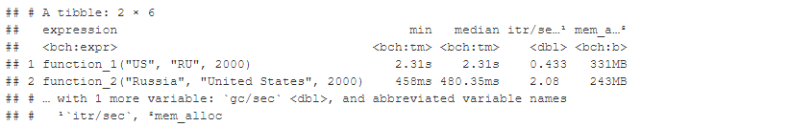
Benchmark output
Pay attention to the units. It is useful to know how many times a function needs to run before it takes a second. If a microbenchmark takes:
* 1 ms, then one thousand calls take a second
* 1 micros, then one million calls take a second
* 1 nanos, then one billion calls take a second
returns the results as a tibble
min, mean, median, mex, and itr/sec. These summarise the time taken by the expression. Focus on the minimum (best possible running time) and the median (the typical time).
mem_alloc tells you the amount of memory allocated by the first run, and n_gc() tells you the total number of garbage collections over all runs. These are useful for assessing the memory usage of the expression.

Slide 12





What’s next? Improving Performance
Approaches to improve code
Code organization
Vectorize code
Balanced approach to code optimization
Checking for existing solutions
Functions do as little work as possible

Slide 13


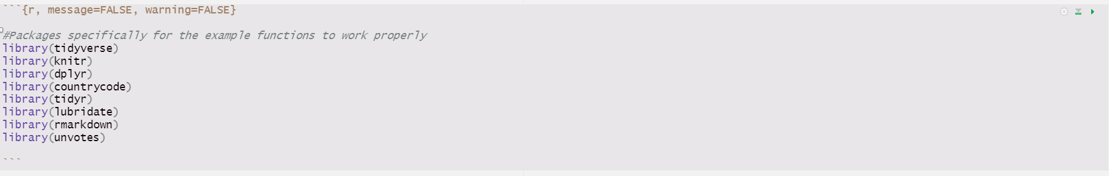
Code Organization
Bench” package
- Compare function speeds
Which executes more quickly? How much memory is utilized?
Function 1
Function 2
Example:
MDS Students’ functions for Problem Set #2 for IDS

Slide 14
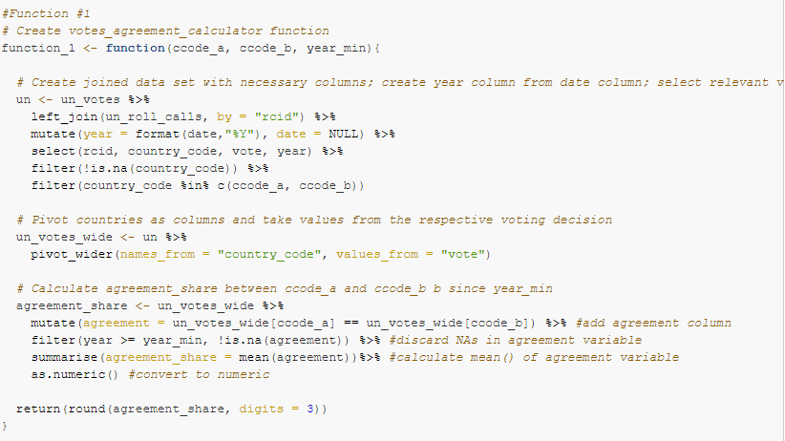
Code Organization – Function #1

Slide 15
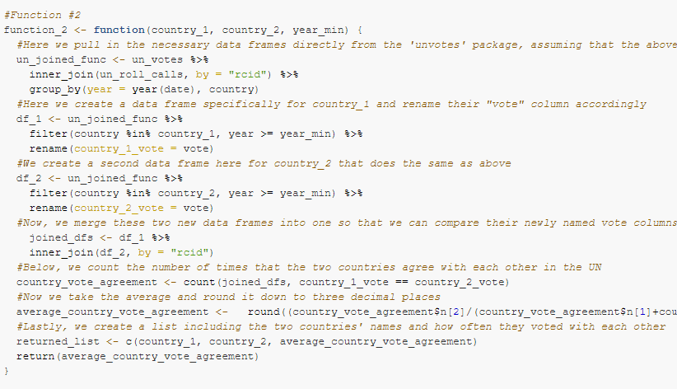
Code Organization – Function #2

Slide 16
Code Organization – Function Comparison
Utilize “bench” to compare the two functions:
Observe the results:

Slide 17
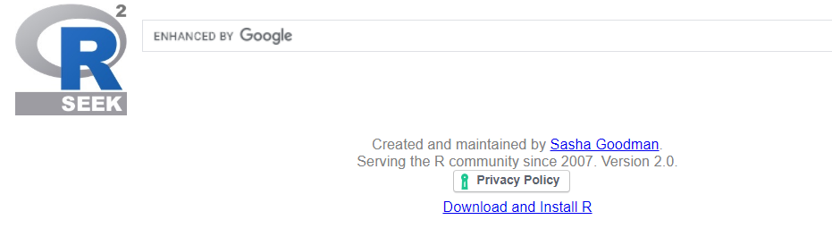
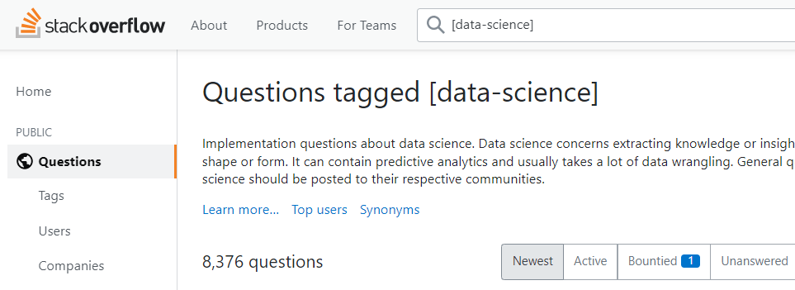
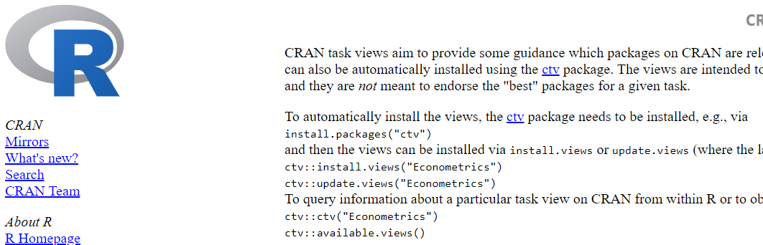
Checking for Existing Solutions
Outside resources:
Online resources:
Rseek at rseek.org
Stackoverflow at stackoverflow.com
CRAN Task Views at cran. Rstudio.com/web/views/
In-person resources:
Colleagues
Professors
Students

Slide 18





Efficient Functions
Have your functions do as little work as possible
Low runtime
Low memory usage
Some functions are faster than others
Requires experience and development of intuition
Examples:
* Readr::read_csv() is significantly faster than read.csv()
* rowSums(), colSums(), rowMeans(), and colMeans() are faster than apply() because they use vectors

Slide 19
Vectorize Your Code
For-loops iterate over a vector one at a time, increasing time and memory usage
Vectorized functions are applied to the entire vector at once rather than one at a time
1
2
3
Use “Microbenchmark” to compare simple functions like the following example

Slide 20
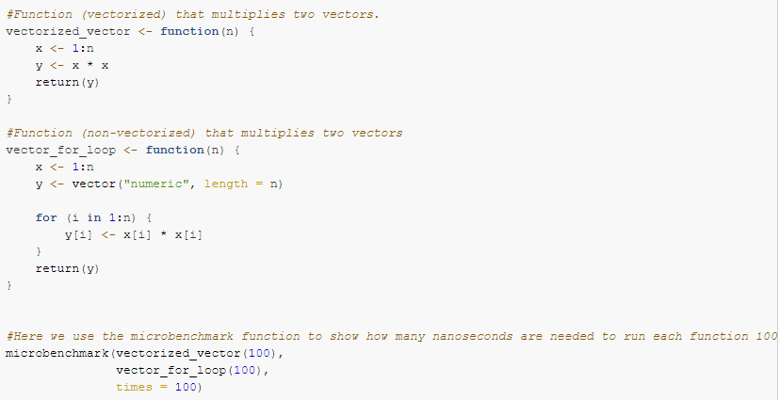
Vectorize Your Code - Example

Slide 21

Vectorize Your Code – Example Output
Observe how many nanoseconds are needed for each function
Vectorized function is much more efficient and quicker

Slide 22
Thanks!

